Slide 1

GITHUB PRESNTATION
BY AMARJEET GUPTA, NARESH CHOUDHARY, ANAND PRASAD

Slide 2

WHAT IS GIT ???
Git is a specific open-source version control system created by Linus Torvalds in 2005.
Specifically, Git is a distributed version control system, which means that the entire codebase and history is available on every developer’s computer, which allows for easy branching and merging.
Git is a free and open source distributed version control system designed to handle everything from small to very large projects with speed and efficiency.
Git is easy to learn and has a tiny footprint with lightning fast performance.
According to a Stack Overflow developer survey, over 87% of developers use Git.

Slide 3
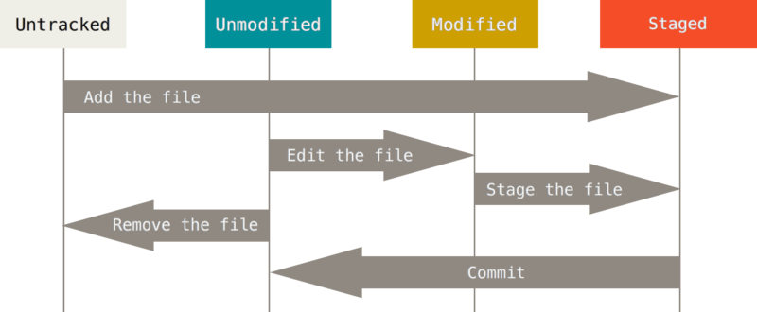
THE LIFECYCLE OF THE STATUS OF YOUR FILES
IN GIT

Slide 4

WHAT IS GITHUB ???
GitHub is an Internet hosting service for software development and version control using Git.
It provides the distributed version control of Git plus access control, bug tracking, software feature requests, task management, continuous integration, and wikis for every project.
It is commonly used to host open source software development projects.
As of June 2022, GitHub reported having over 83 million developers and more than200 million repositories, including at least 28 million public repositories.
It is the largest source code host as of November 2021.

Slide 5
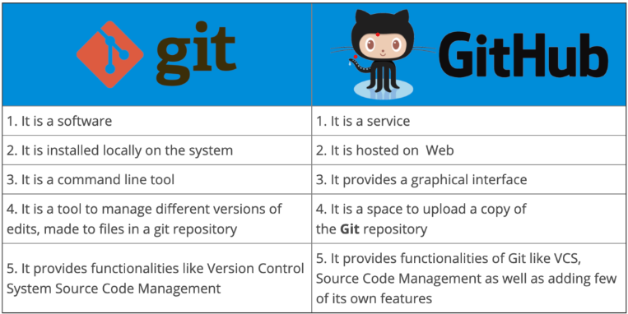

Slide 6
WHY TO USE GITHUB
It's used for storing, tracking, and collaborating on software projects.
It makes it easy for developers to share code files and collaborate with fellow developers on open-source projects.
GitHub also serves as a social networking site where developers can openly network, collaborate, and pitch their work.

Slide 7



FEATURES OF GITHUB
Easy Project Management
GitHub is one place where project managers and developers coordinate, track , and update their work so projects stay transparent and on schedule.
Increased Safety with Packages
The packages can be published privately, or with in the team or publicly for the open source community. The packages can be used or reused by downloading it from the GitHub
Effective Team Management
GitHub helps all the team members to stay on the same page and stay organized. Moderation tools like issue and pull request locking helps the team to focus on the code.

Slide 8
CONCLUSION
Every beginner programmer should use GitHub to keep his work or project safe

